Slide 1
De-stress Programs
Cullom-Davis Library
Bradley University
Peoria, Illinois

Slide 2
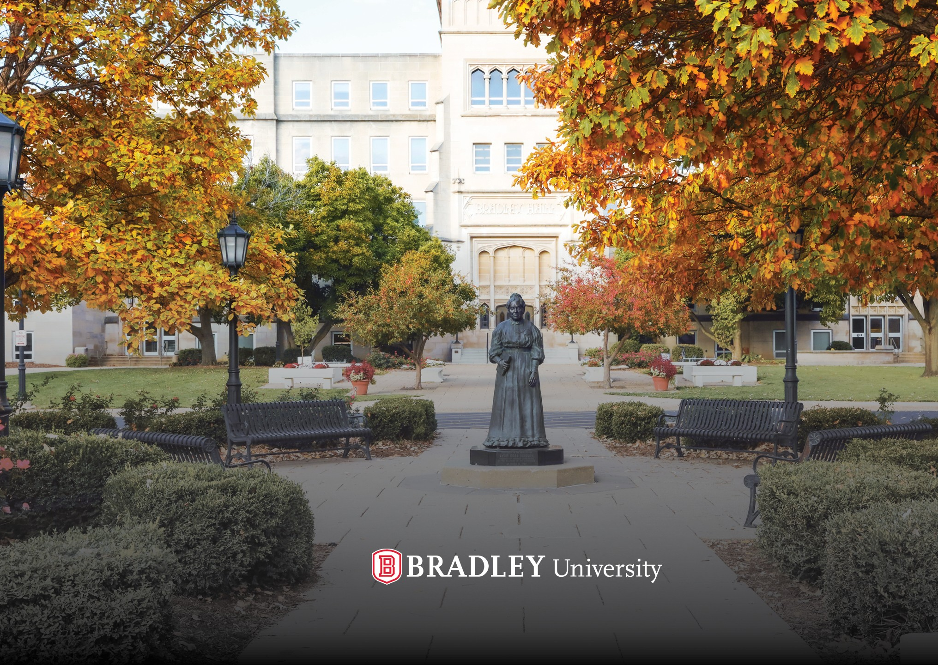
Bradley University
Private, mid-sized, comprehensive university in Peoria, Illinois

Slide 3
Special thanks to the Cullom-Davis Library Engagement Committee

Slide 4
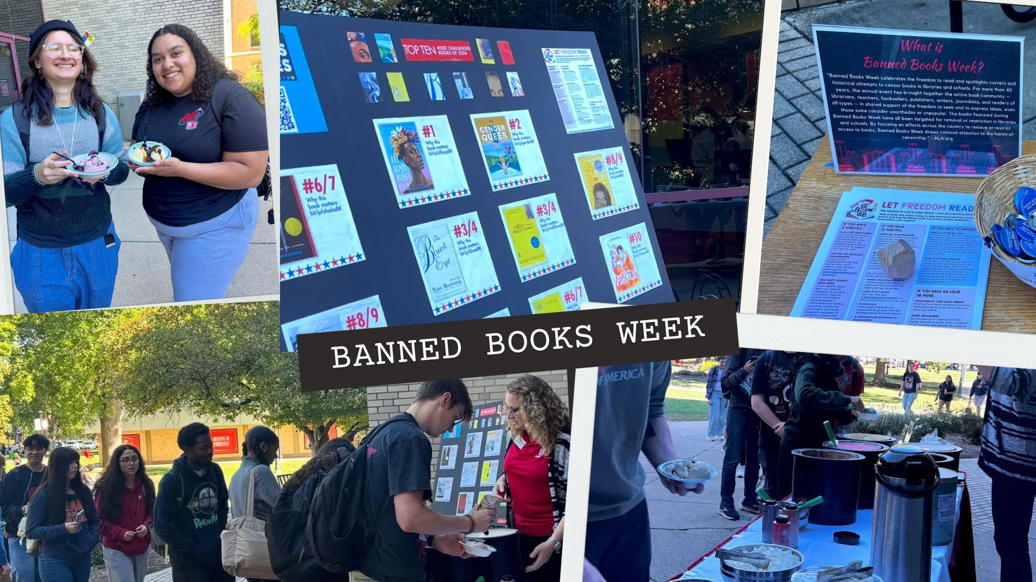
Banned books week

Slide 5
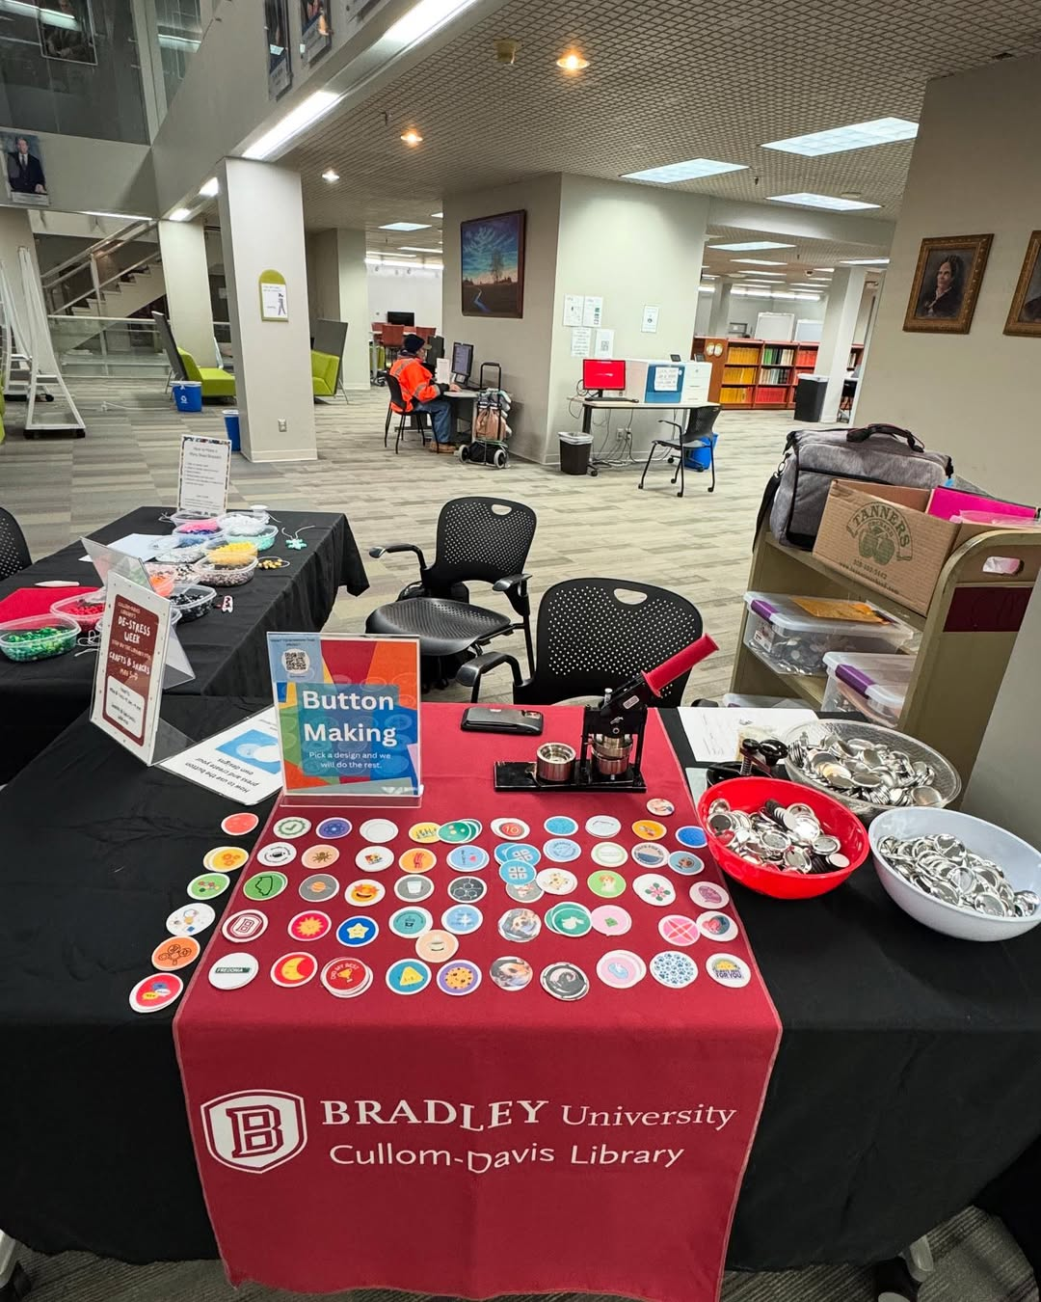
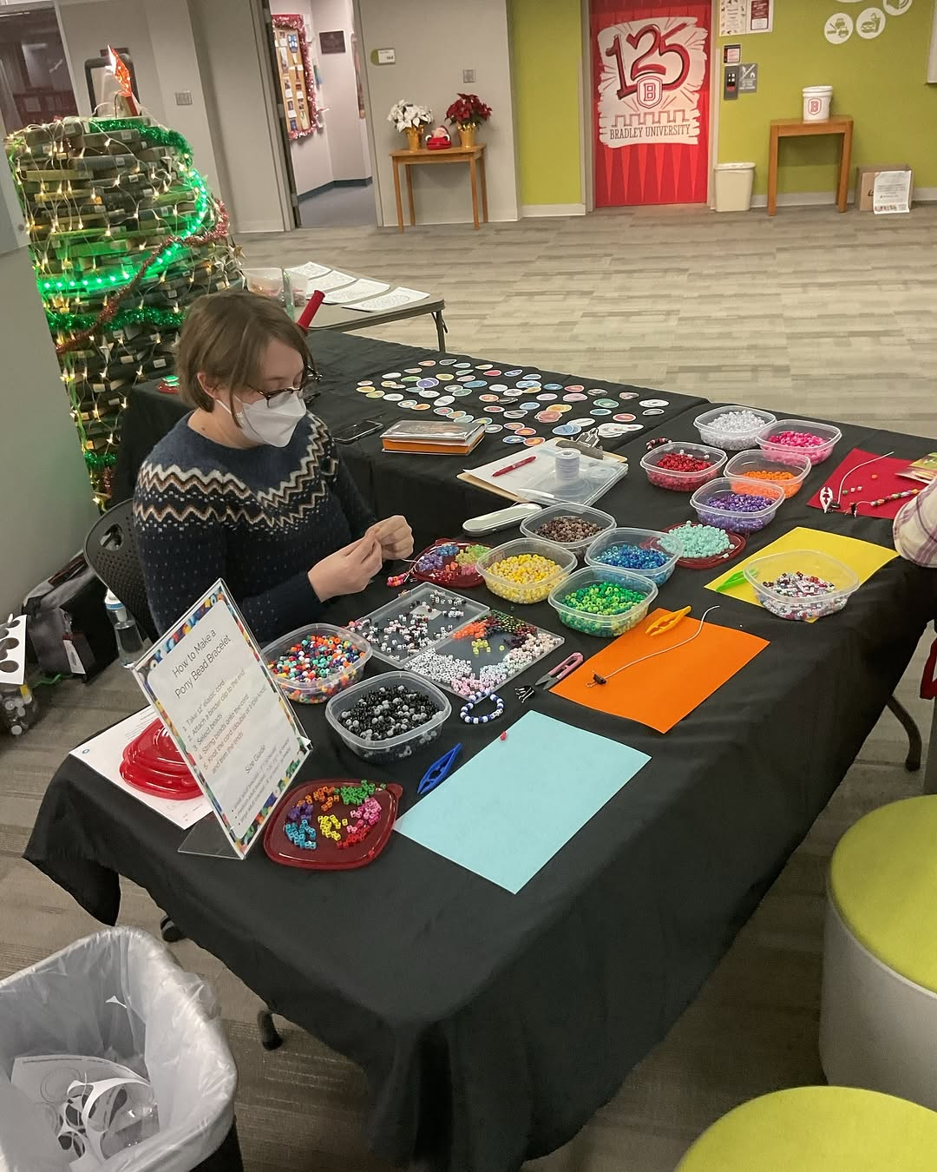
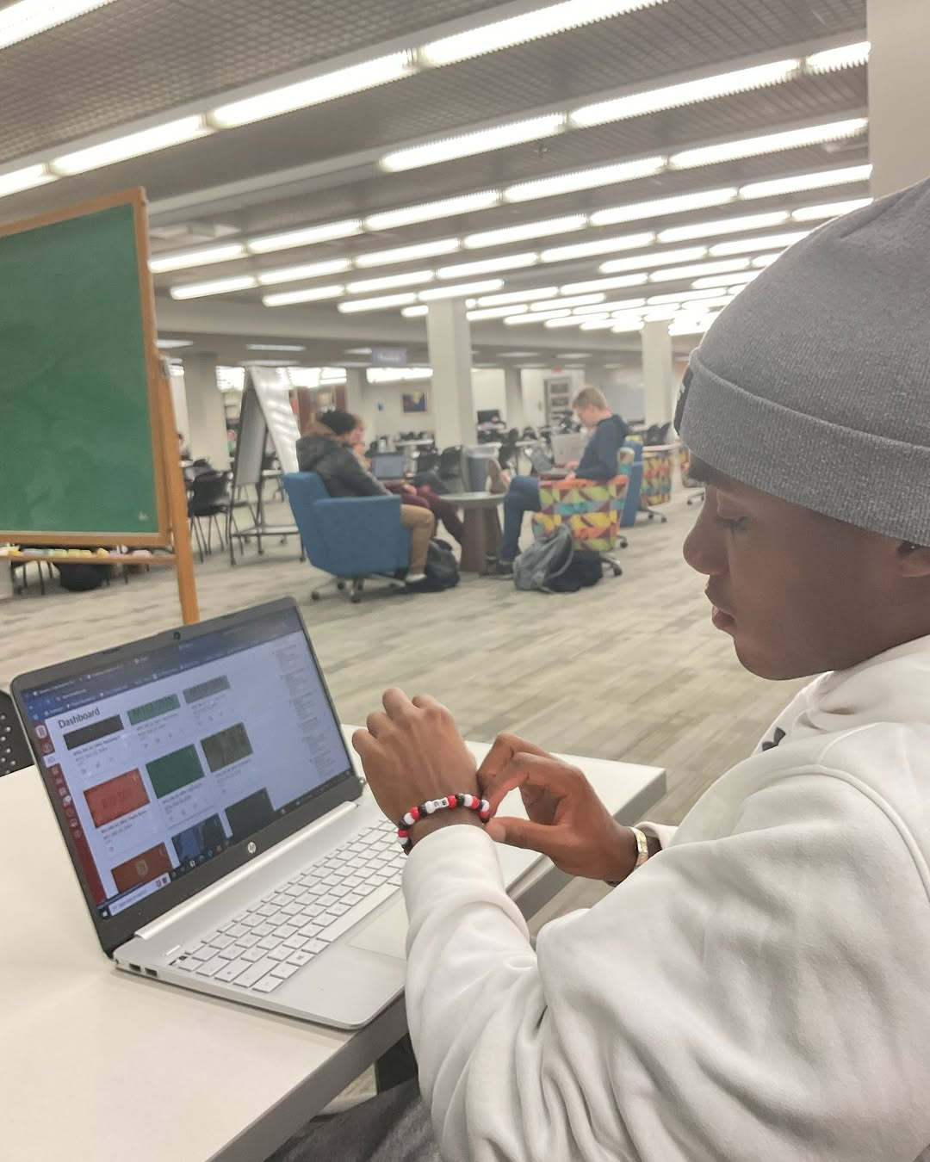
We love crafts
We Love Crafts

Slide 6
Beat the February Blues
Murder Mystery
Therapy Dogs
Plants

Slide 7

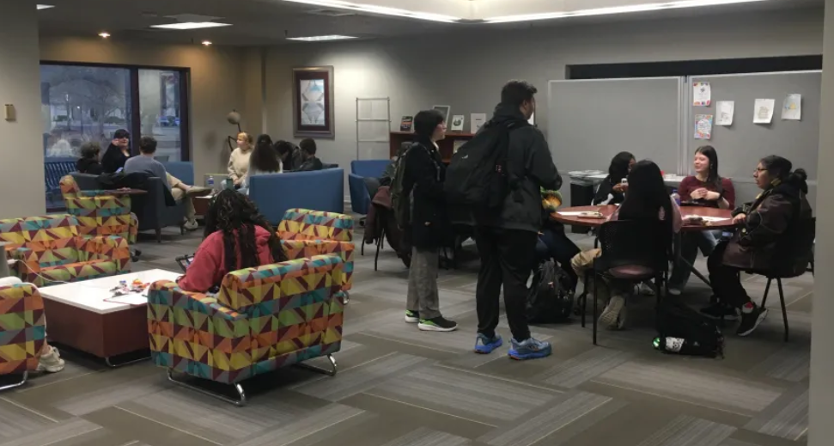
Murder Mystery Event

Slide 8

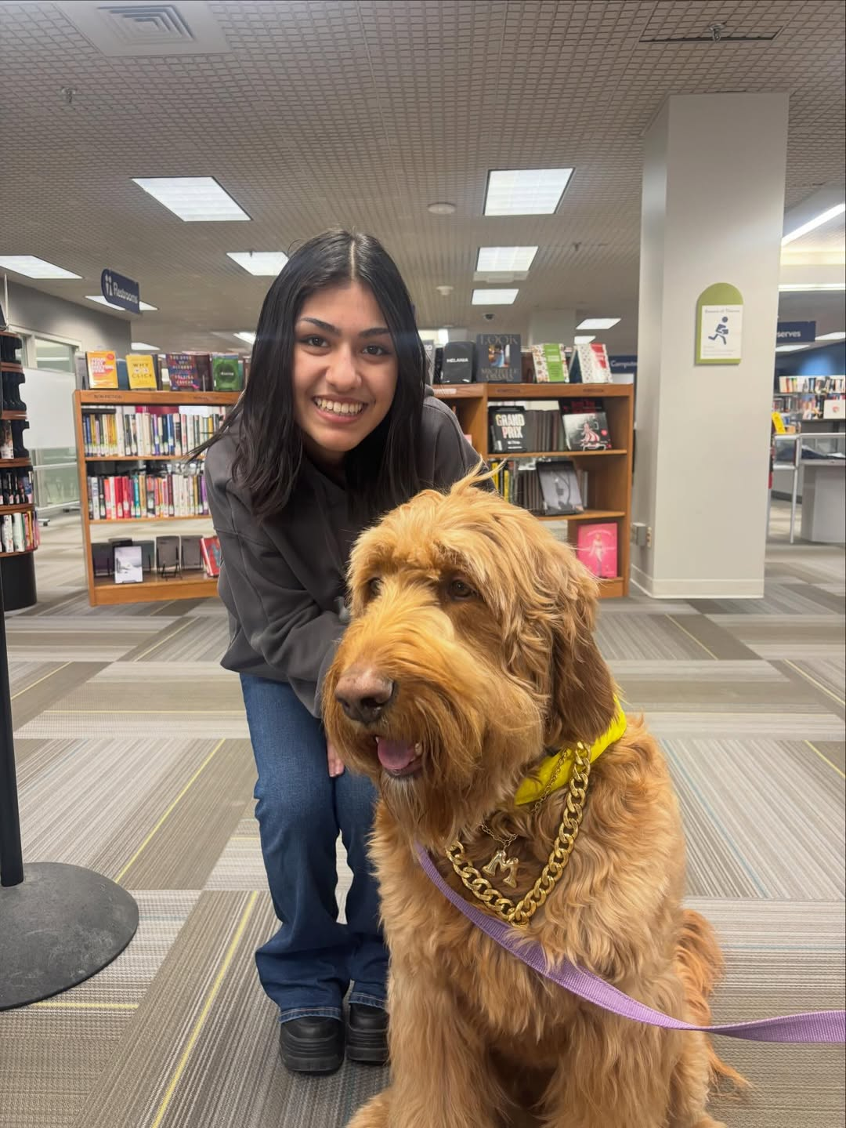
Therapy Dog Event

Slide 9
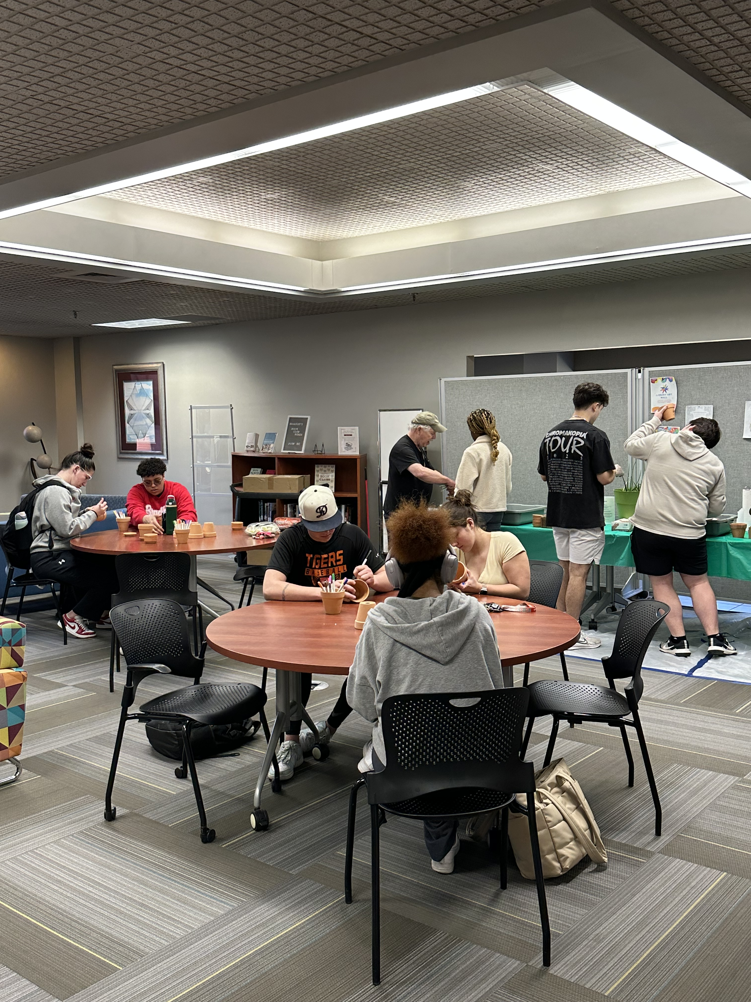

Need a Little “Plant” Me Up?

Slide 10


Need a Little “Plant” Me Up? Care Sheets

Slide 11
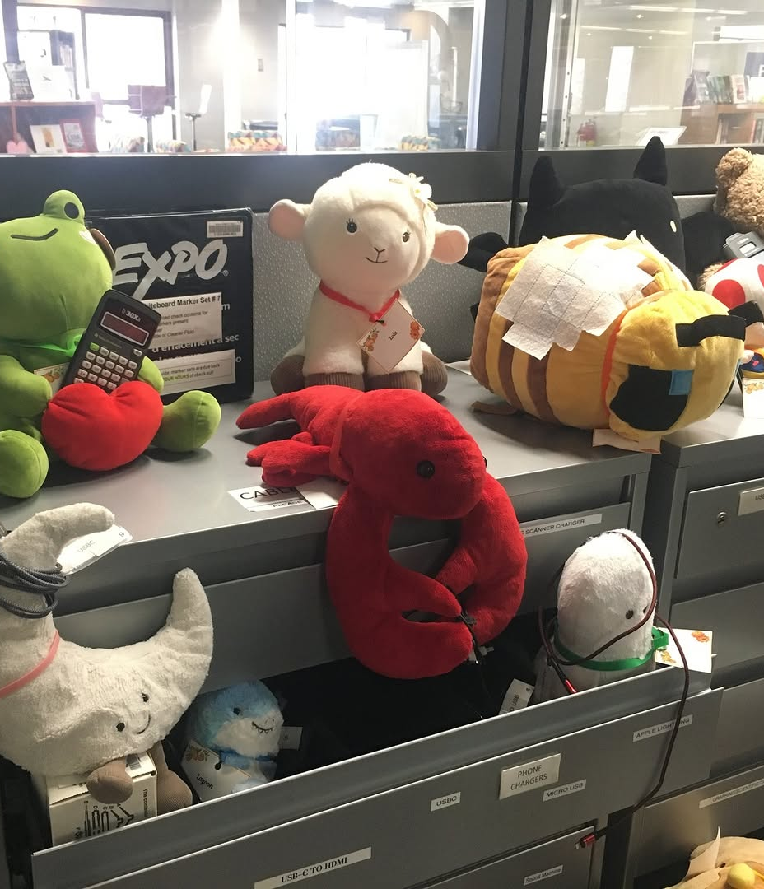

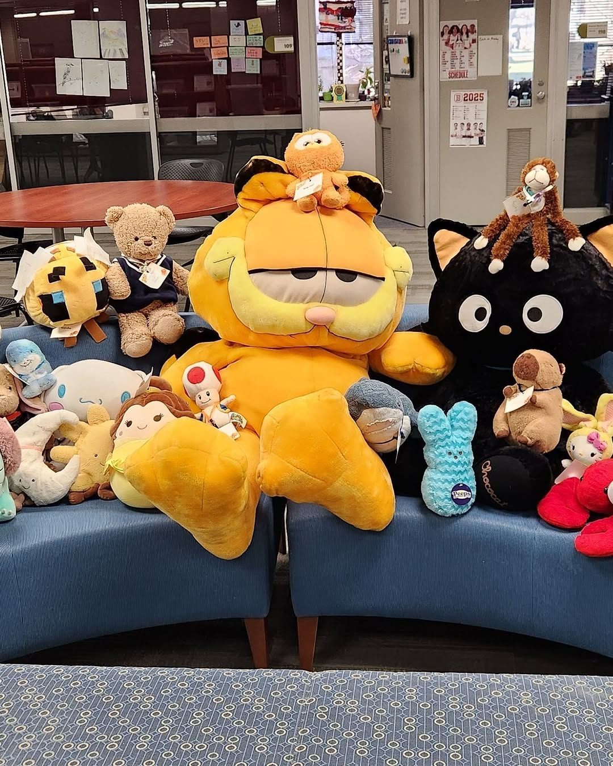
Stuffy Camp Over Spring Break
FamilyID=Office_ArchiveTorn

Slide 12
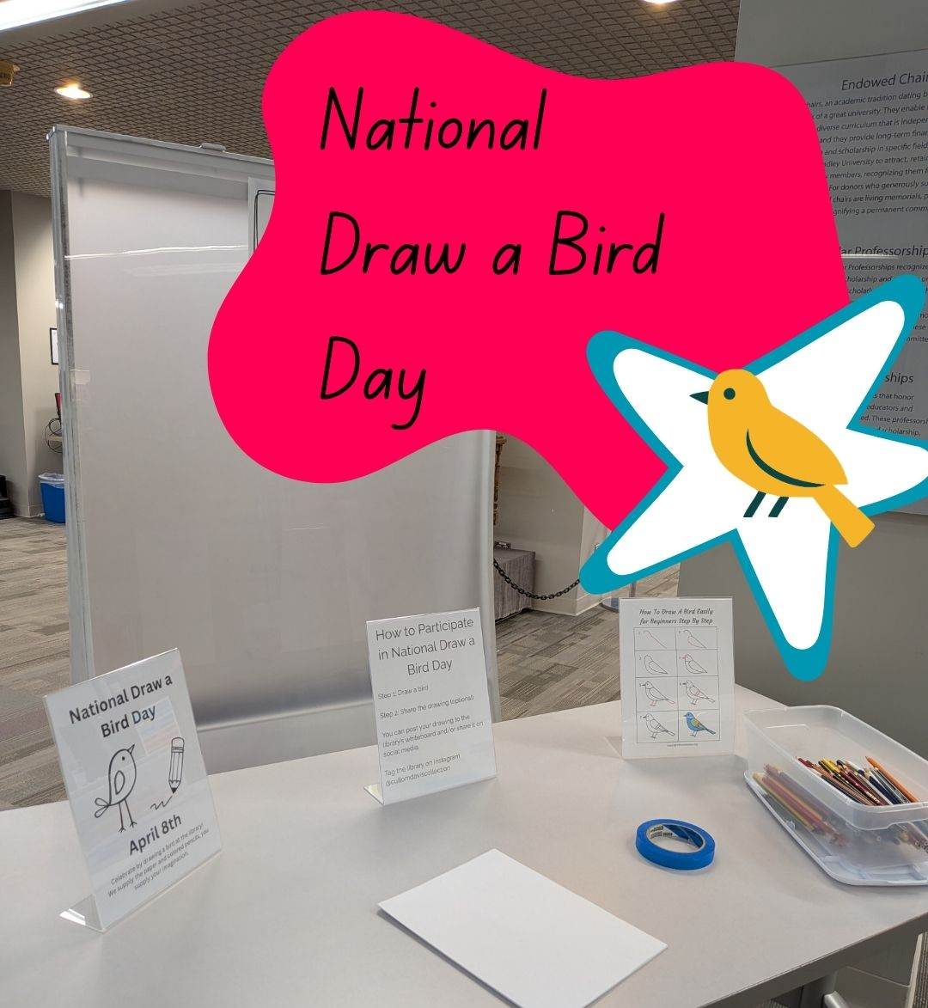
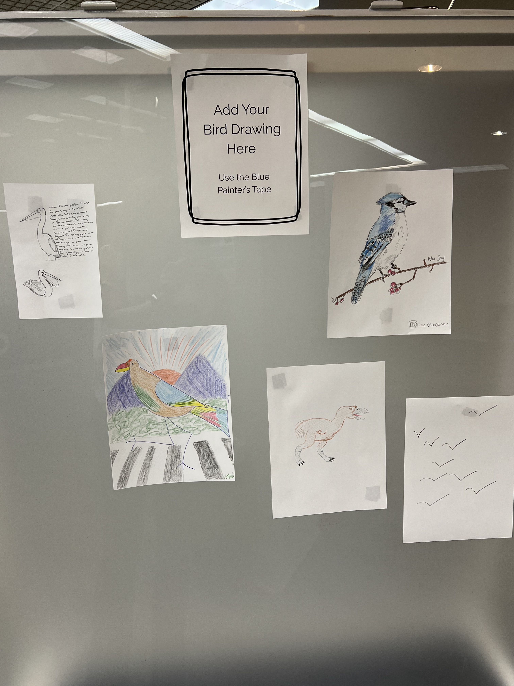
National Draw a Bord Day Passive Program

Slide 13

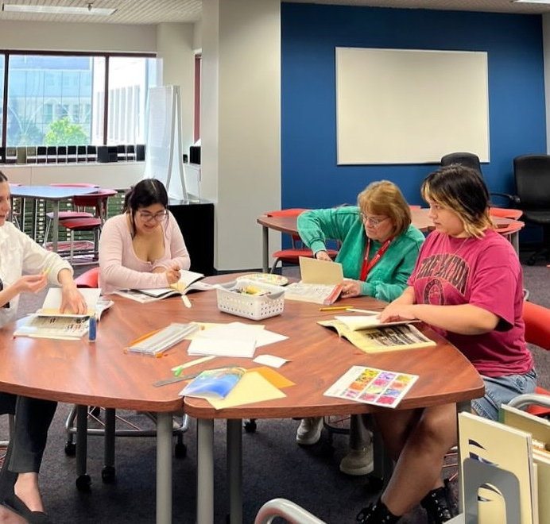
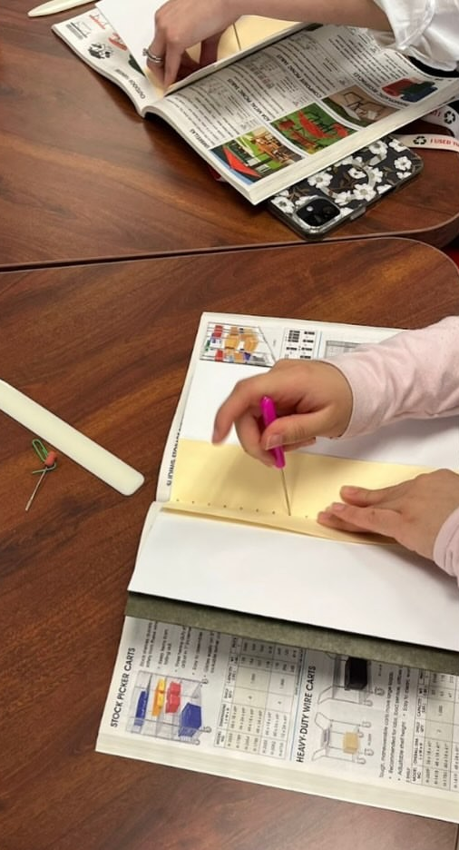
Sew you like a book event

Slide 14

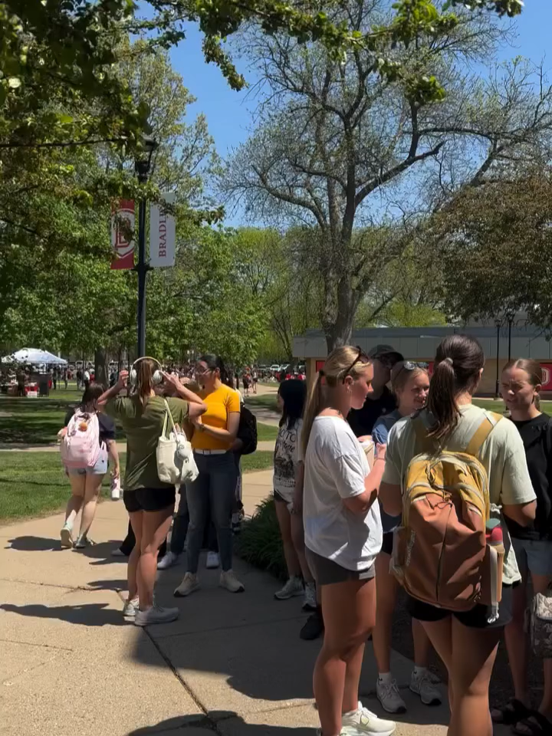
National Library Week Ice cream and popsicles social

Slide 15
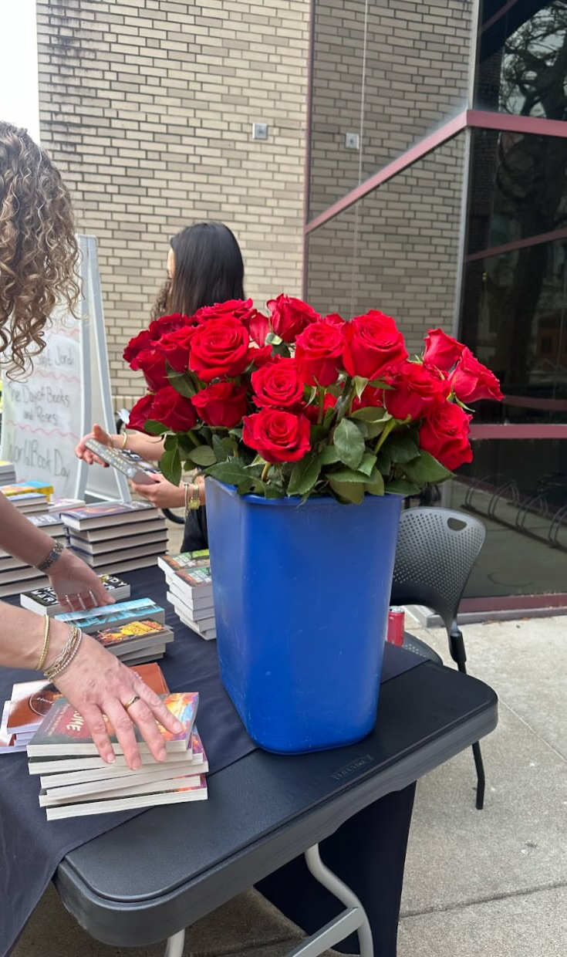

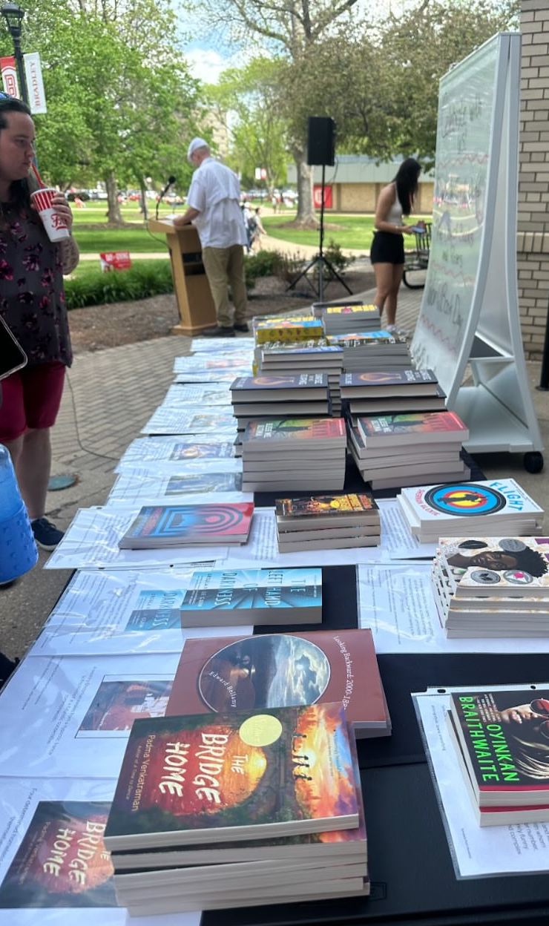
Sant Jordi Day Event

Slide 16



Book Display for Self Care and De-stressing

Slide 17
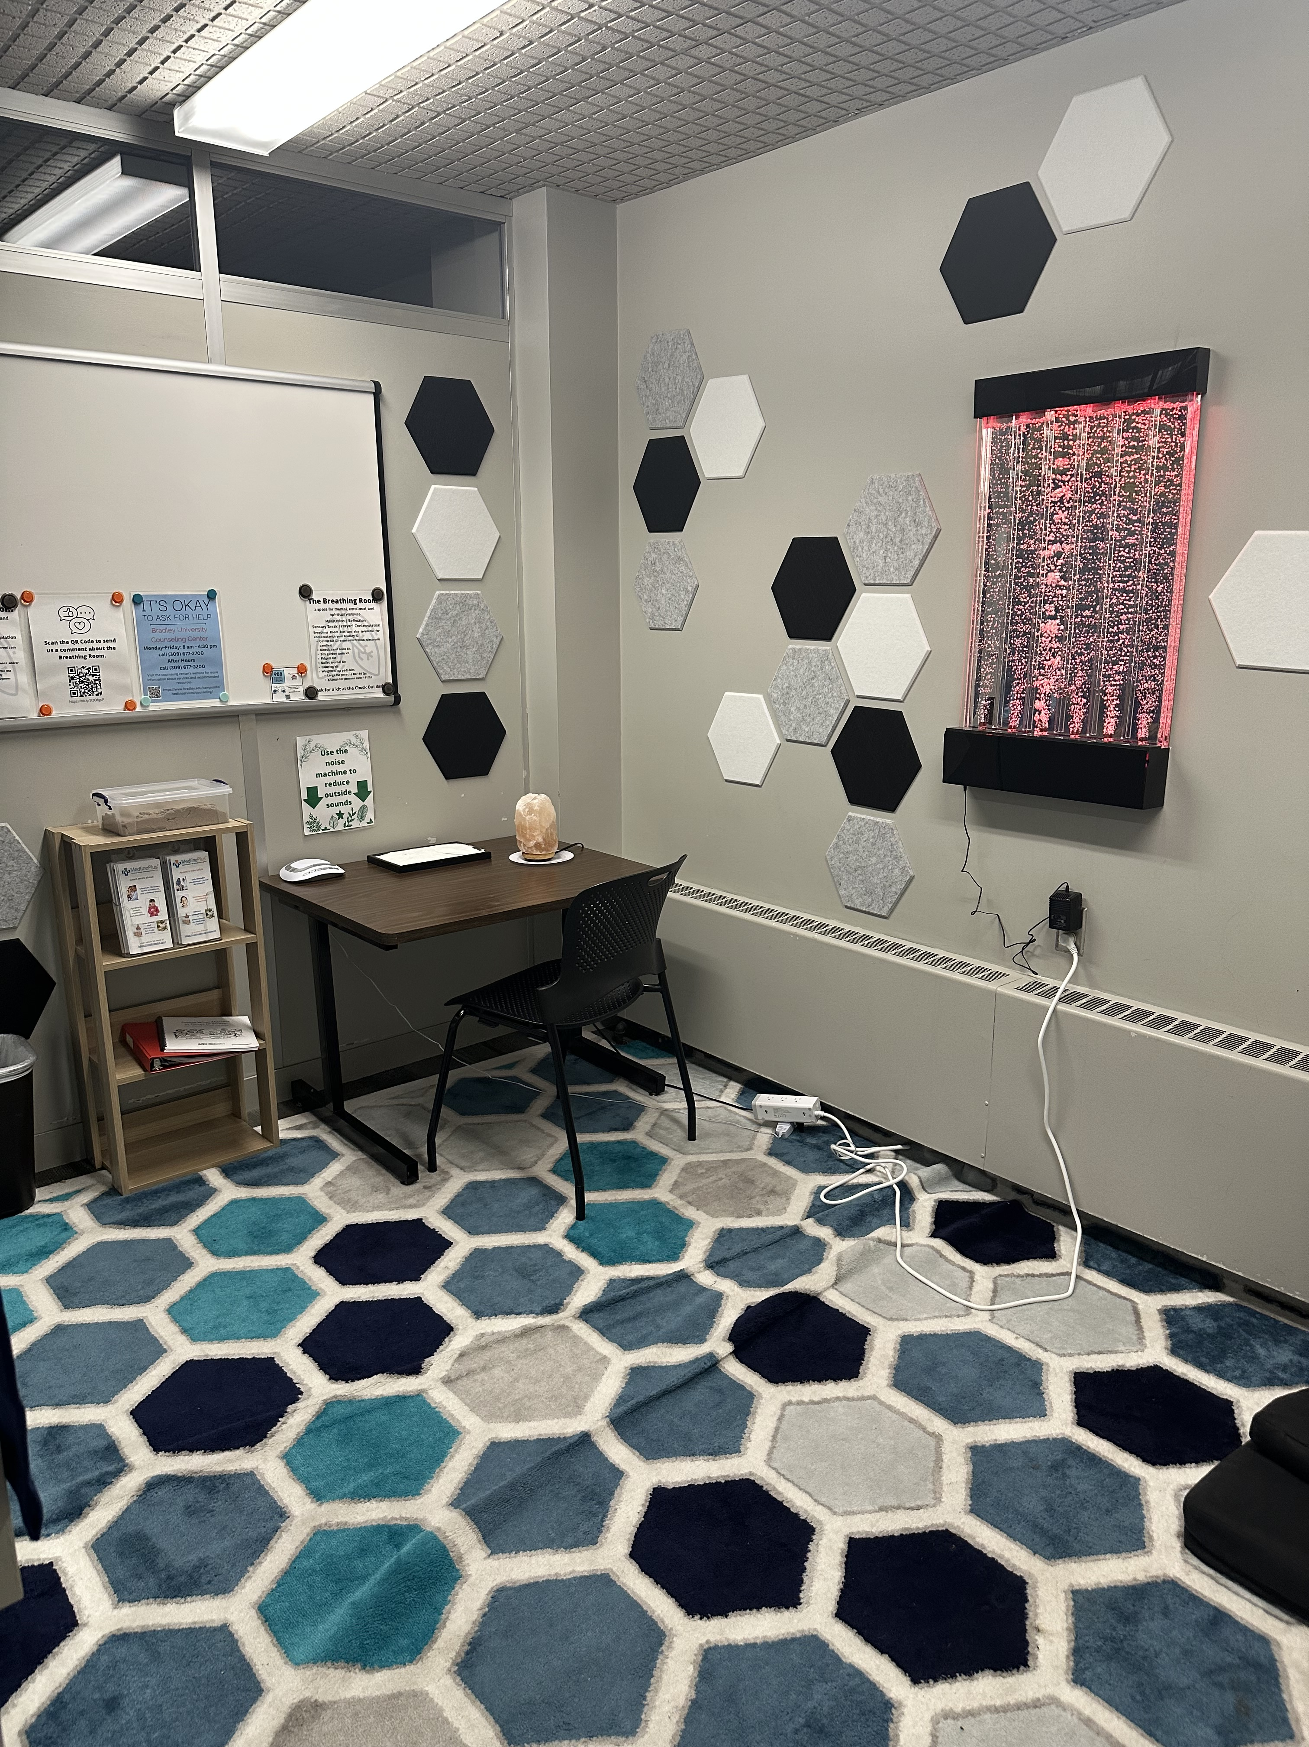
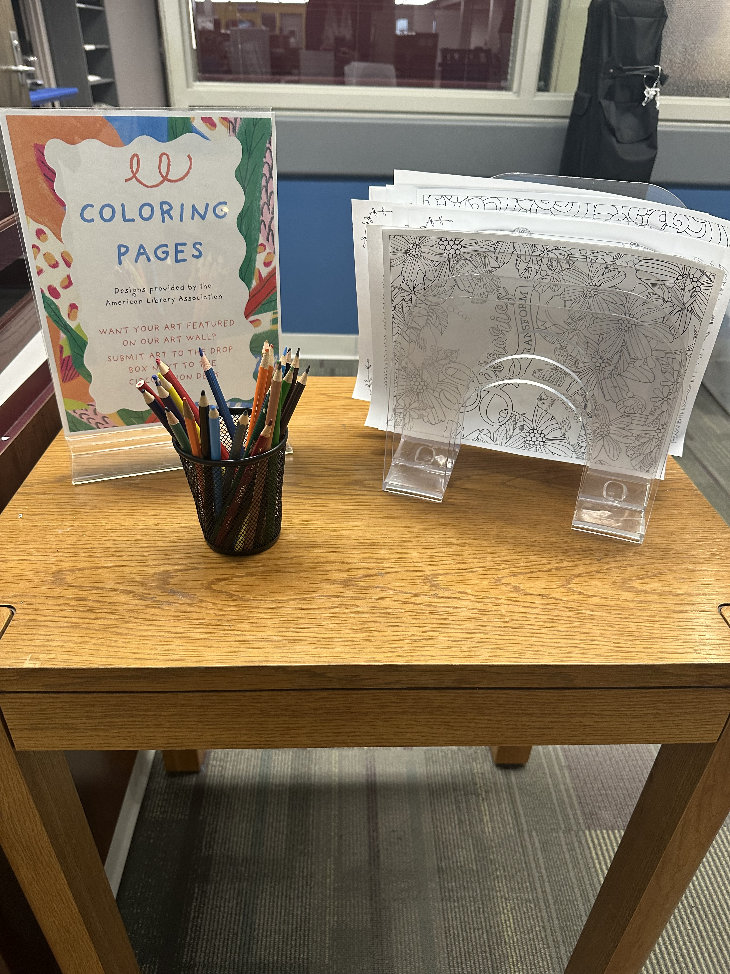
Library Offerings for De-Stressing

Slide 18

Follow us on social media

